Slide 1
Proactive Network Maintenance and Signal Leakage

Slide 2
Agenda
Proactive Network Maintenance (PNM)
Impedance Mismatch
Micro-Reflections
US Frequency Response & Pre-EQ Tap Display
The Marriage
Pressure Testing
Shielding Integrity
Successes

Slide 3
A PNM Goal Frequency Response ≤ 0.5 dB Each Bonded Channel
All PNM Traces Courtesy Nimble This (Brady Volpe)
Notes:
Two channels capable of bonding
Frequencies close enough so that path disturbances should look similar in both channels
Minimize impedance discontinuities
Not practical to eliminate all the wrinkles

Slide 4
Nominal Impedance Measles Chart
Notes:
Every device and every connection presents a mismatch opportunity
All devices and the interconnecting cable specified to have a NOMINAL impedance of 75 ohms.
Explain Return Loss specification

Slide 5
Creating Micro-Reflections
Fiber Node
Notes:
Discuss distances without mentioning echo tunnels

Slide 6
The CMTS Challenge Modem to CMTS US Frequency Response
All PNM Traces Courtesy Nimble This (Brady Volpe)
Notes:
During registration, the modem sees this frequency response
Sends correcting coefficients to the modem’s pre-equalizer

Slide 7
CMTS Solution CMTS to MODEM Pre-Equalizer Correction
All PNM Traces Courtesy Nimble This (Brady Volpe)
Notes:
Describe the chart
Taps
Coefficients
Math Lesson next

Slide 8
😱
JUST KIDDING 🤡

Slide 9
Transmission Speed
64-QAM US Symbol Rate = 5.12 mega-symbols/second (ms/s)
1 symbol transmitted every 1 / 5.12E6 = 195.3E-9 or 195.3 nanoseconds (nsec)
One-way trip @ VOP = 87 %, (195.3 x 0.87) = 169.9 / 2 = 84.995 nsec
Notes:
OFDMA will be quite different.

Slide 10
Speed of Light
186,282.4 Miles per second (in a vacuum)
< 5th century assumed infinite
5th century Empedocles questioned the assumption
6th century Aristotle disagreed – back to infinite
1629 Isaac Beeckman used mirrors and exploding gunpowder
1638 Galileo used lanterns spaced at known distances
1676 Römer studied Jupiter’s moons & earth’s diameter (27%)
1729 Bradley improved the accuracy but Römer wins the honor
And then, along came lasers - filled in the 27%
Notes:
5th century Empedocles questioned SOL was infinite
6th century Aristotle disagreed
1629 Isaac Beeckman experimented with mirrors and exploding gunpowder
1638 Galileo proposed using lanterns at some known distance
1676 Römer studied Jupiter’s moons and used the diameter of Earth got within about 27%
1729 Bradley improved on the accuracy, but Römer wins the honor of proof.
Information necessary to understand the Echo Tunnel Concept

Slide 11
Speed of Light
186,282.4 Miles per second (in a vacuum)
186,282.4 x 5,280 = 983,571,056 feet per second
1 / 983,571,056 = 1.0167 nanoseconds per foot
Conclusion
Since 1 symbol is transmitted every 84.995 nsec, and
there is 1 Pre-Equalizer Tap per symbol, and
traveling speed is 1 nsec/foot,
the distance between Pre-EQ bars is about 85 feet.
Notes:
5th century Empedocles questioned SOL was infinite
6th century Aristotle disagreed
1629 Isaac Beeckman experimented with mirrors and exploding gunpowder
1638 Galileo proposed using lanterns at some known distance
1676 Römer studied Jupiter’s moons and used the diameter of Earth got within about 27%
1729 Bradley improved on the accuracy, but Römer wins the honor of proof.
Information necessary to understand the Echo Tunnel Concept

Slide 12
Echo Tunnel Concept
All PNM Traces Courtesy Nimble This (Brady Volpe)
Notes:
Each bar represents the proportion of input signal routed through fixed-delay Equalizer Taps (not to be confused with House Taps)
Spacing between bars is about…85 feet.

Slide 13
Clustering or Not
Independent
Clustered

Slide 14
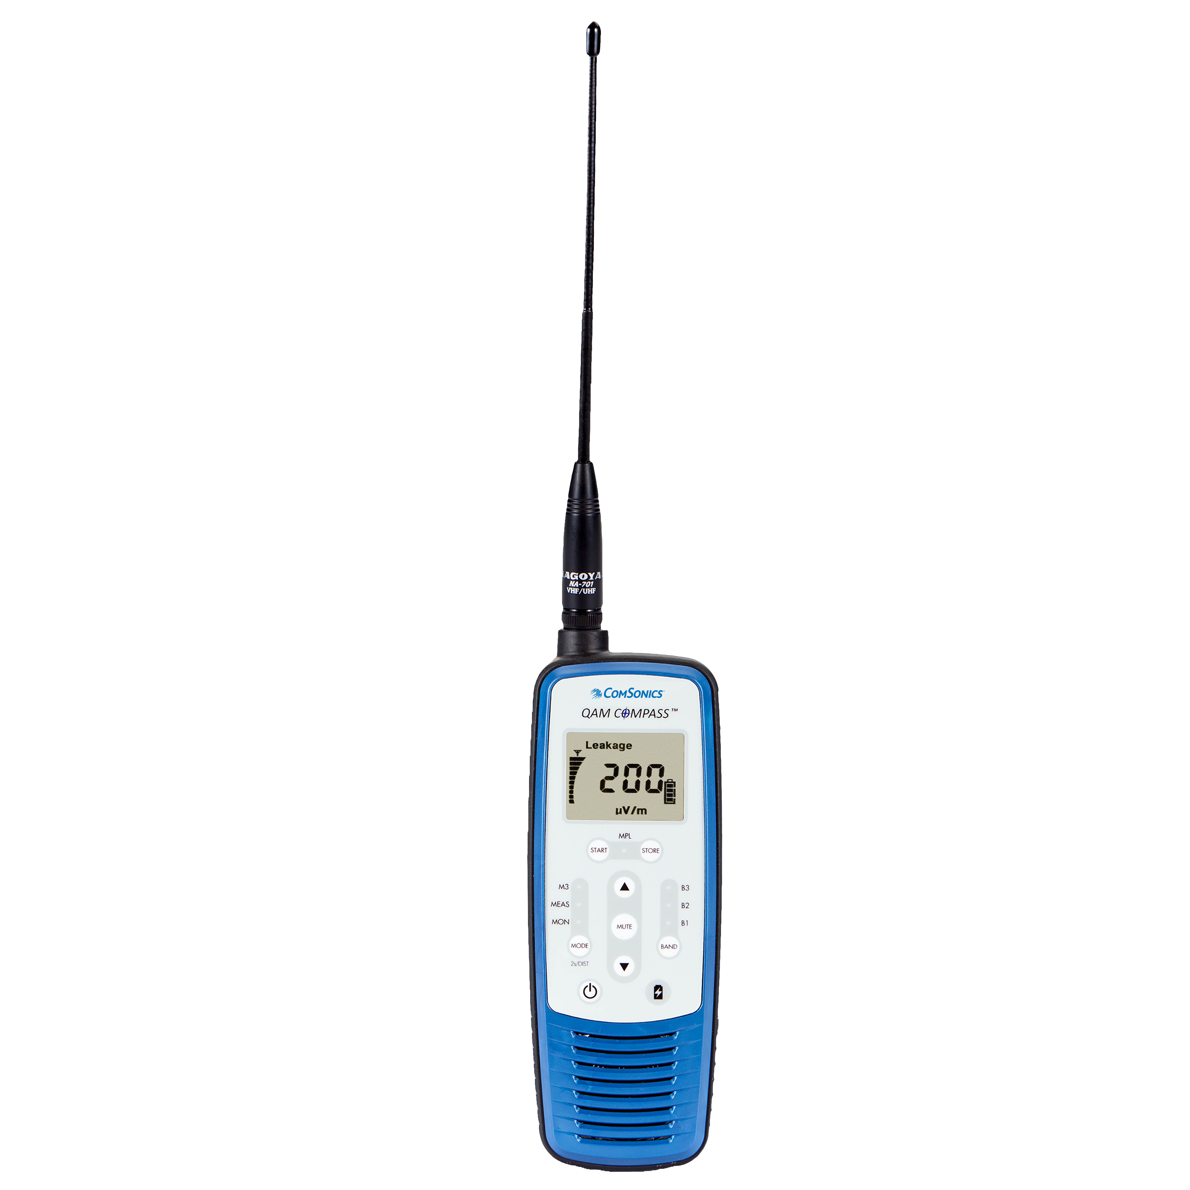
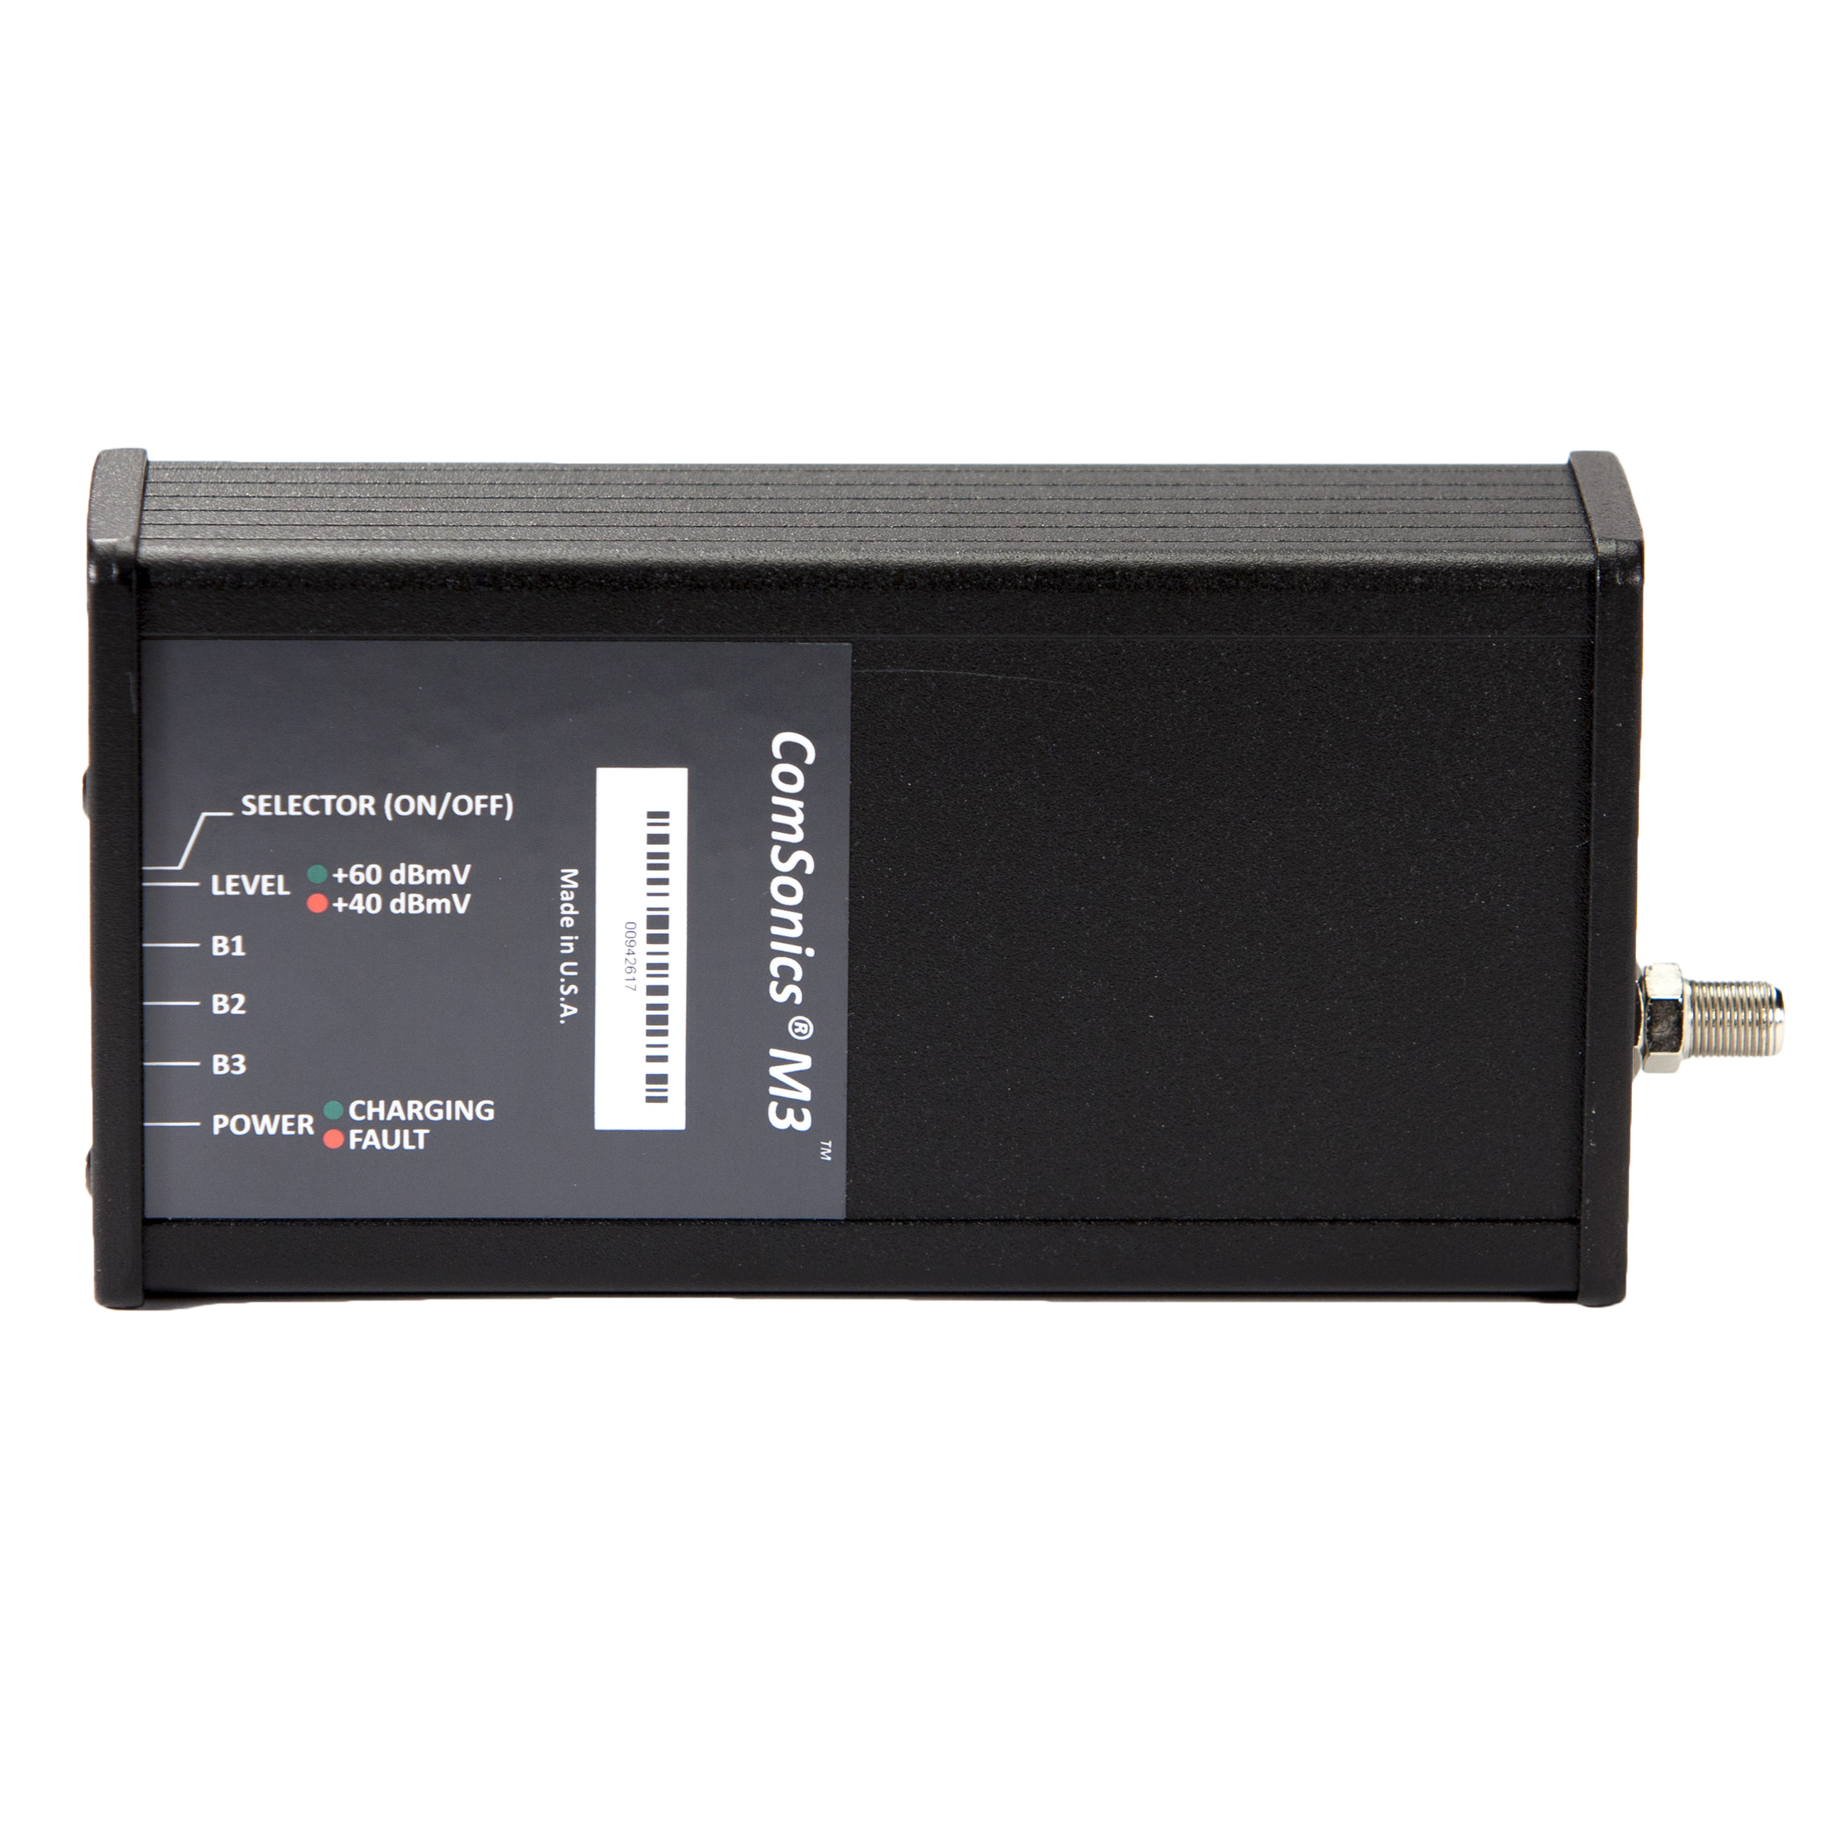
Pressure Testing Tools
Compass
Leakage Detector
M3 Signal Source

Slide 15
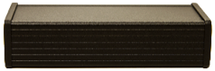
Pressure Testing
M3 Marker signal
TV
TV
TV
VHF and UHF
Triple Frequency Scan
M3 Generates a unique marker at +40 or +60 dBmV
Detects sources of drop system flaws with shielding integrity > 120 dB
Allows detecting integrity flaws without entering customer premise

Slide 16
Shielding Integrity About 40 reasons to Maintain
Power lines & their hardware (hum, arc, spark, corona buzz, • AC light dimmers • Electric fences • Computers + all microprocessors with digital clocks (oscillator) • Brush-type motors (vacuum, sewing machine, power tools) • Thermostats, power controllers, motor controllers (washer, dryer, fridge, etc.) • Fluorescent lights, touch lights, neon lights • Bug zappers, electric fences, ignition pulses • Cordless phones, baby monitor • Weird stuff: doorbell transformer, electric blanket, fish tank thermostat DVD + Blu-Ray players • In-line or “wall-wart”-type laptop power supplies (especially switcher-type) • Newer front-loading washing machines • Computers, tablets, smart phones (some good, some BAD!) • Plasma flat-screen TVs (most BAD) • Automotive engine computers (some) • ADSL box/desktop computer combination • ”Touch” –controlled lights, faucets, etc. • “Coil”-type fluorescent bulbs –some quiet, some bad • Wireless modem jacks, digital cable converters • LED light assemblies for house lighting (120 VAC)

Slide 17
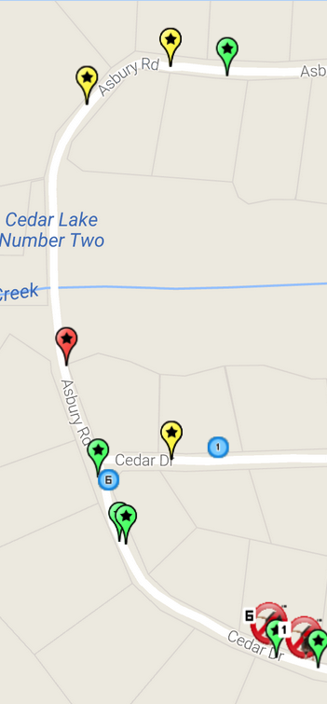
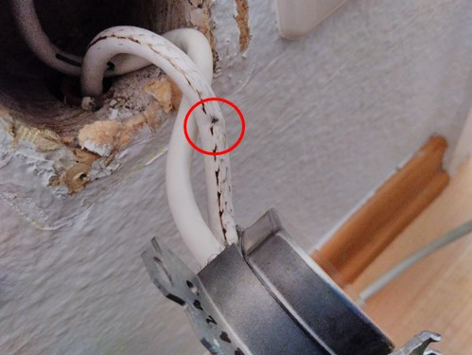

PNM: Elevated Taps 9 & 10 Can Indicate an In-Home Issue
Problem: Damaged cable inside wall plate
Single Home with No Network Leakage Points to an In-Home Problem

Slide 18
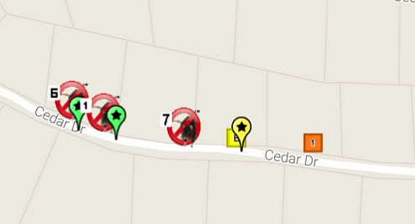
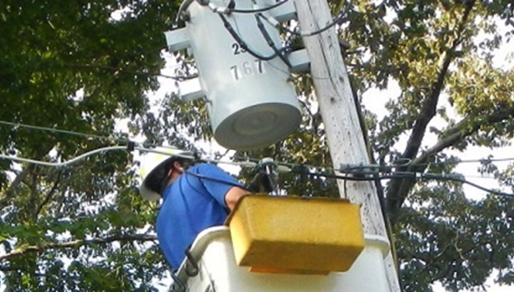
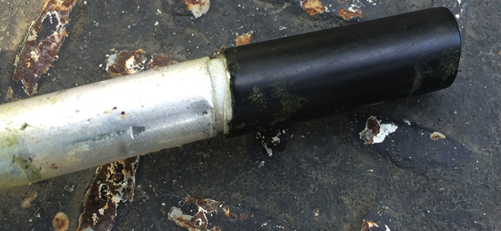
PNM: Higher Numbered Taps Can Indicate A Network Issue
Problem found: Crack in the hardline
PNM Data Provides Clues to the Location of the Problem
These homes exhibit elevated taps 11 through 15
A cluster of homes with elevated taps indicates a possible network shielding flaw Issue.

Slide 19
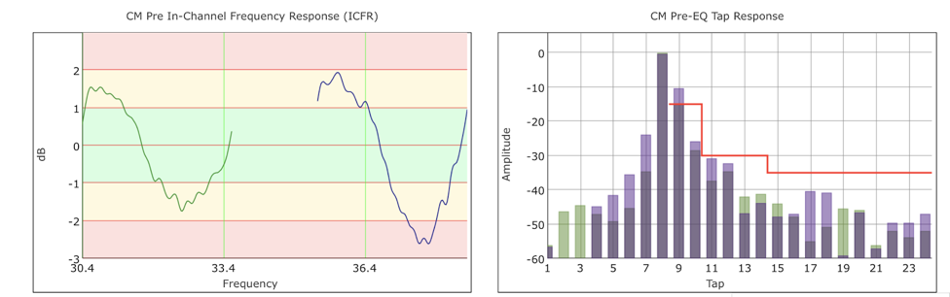
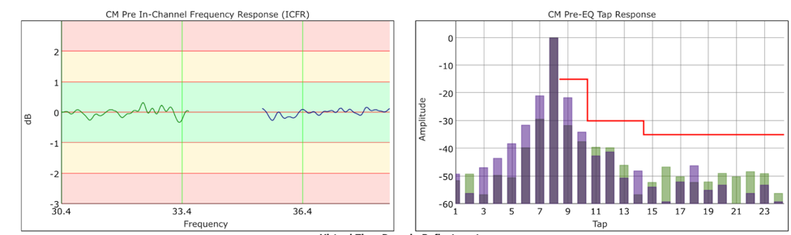
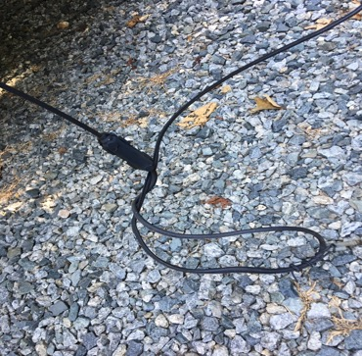
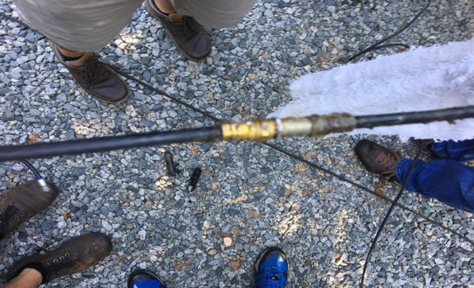
Home 1
Before
After
Problem Found: In-Line Drop Splice with Corroded Crimp Connector

Slide 20
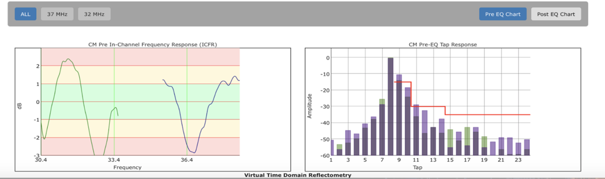
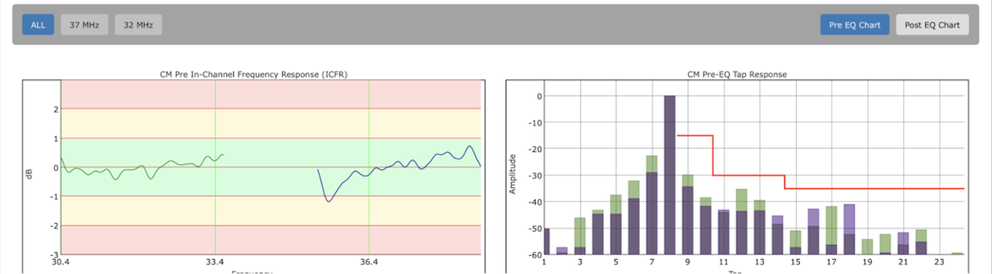
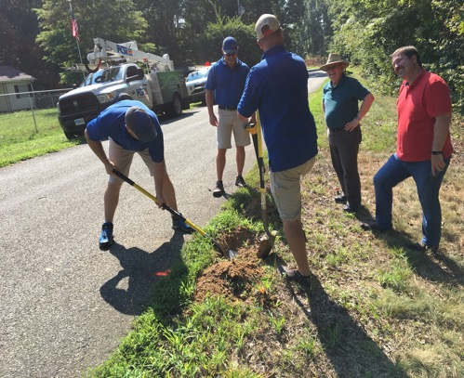
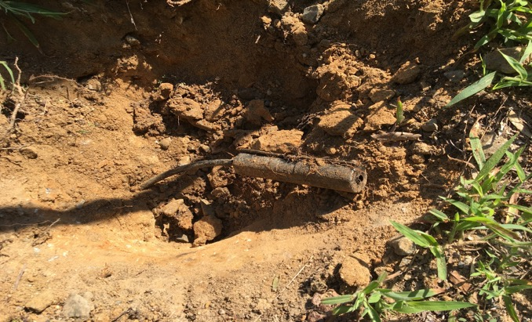
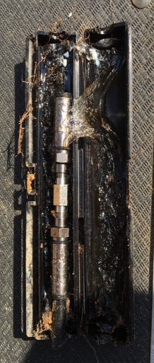
Home 2
Before
After
Problems Found: Flawed connector makeup in buried splice enclosure resulting in corroded connectors and bad drop filter in pedestal

Slide 21
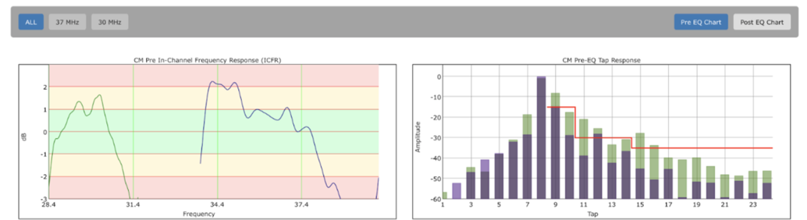
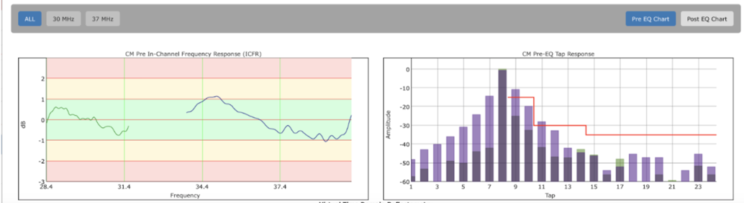
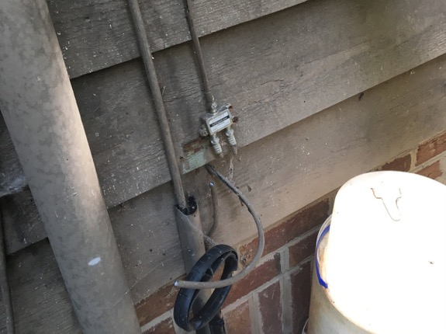
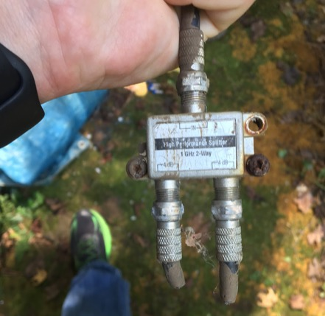
Home 3
Before
After
Elevated taps to the left of the main tap indicates group delay and is likely a network problem.
Problems Found: Bad splitter with twist-on connectors

Slide 22
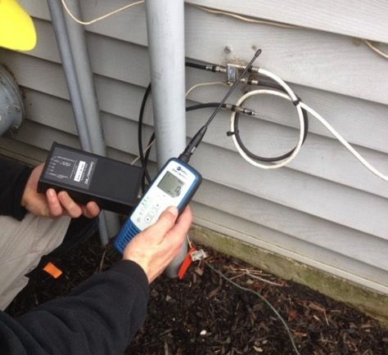
PNM and M3/Compass Field Test Results
➕
15 homes in this study; 100% had cable defects that were identified by the M3/Compass
Cable defects detected with the M3/Compass resolved micro-reflection issues in 13/15 (87%).
Two homes had issues with in-line filters that were unidentifiable until leakage was resolved.
PNM and M3/Compass can dramatically improve technician troubleshooting effectiveness

Slide 23
Conclusion
The marriage between Proactive Network Maintenance techniques and Pressure Testing drop system wiring proves an all-out winner by providing the means to identify, locate and fix issues well before the customer becomes aware of an issue.

